Slide 1
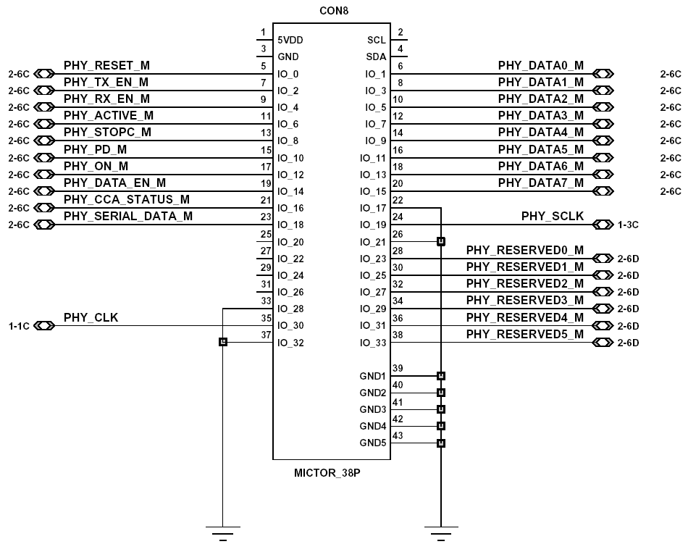
MAC-PHY Interface Connector Drawing

Slide 2
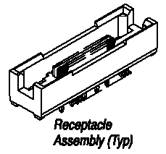
MAC-PHY Interface Connector
Manufacturer Part #: | 5767054-1
Manufacturer: | Tyco Electronics / AMP
Description: | MICTOR Connectors 38P RECEPTACLE
Product Highlights:
Connector
Receptacle
Mated Stack Height (Vertical) = 6.60 mm
Number of Positions = 38
Vertical Mount Angle

Slide 3
Interface Signal Definition(1/2)
Signal Name | From | To | Description
PHY_RESET | MAC | PHY | PHY Reset
PHY_PD | MAC | PHY | Power Down
PHY_ON | MAC | PHY | PHY Sleep/Idle
PHY_SCLK | PHY | MAC | Serial Interface Clock
PHY_SERIAL_DATA | MAC/PHY | PHY/MAC | Serial Interface Data Register Access
PHY_DATA_EN | PHY | MAC | Parallel Interface Enable
PHY_CLK | PHY | MAC | Parallel Interface Clock
PHY_DATA[7:0] | MAC/PHY | PHY/MAC | Parallel Interface Data

Slide 4
Interface Signal Definition(2/2)
Signal Name | From | To | Description
PHY_TX_EN | MAC | PHY | Transmission Enable
PHY_RX_EN | MAC | PHY | Reception Enable
PHY_ACTIVE | PHY | MAC | PHY Active
PHY_STOPC | MAC | PHY | PCLK ON/OFF
PHY_CCA_STATUS | PHY | MAC | CCA status
PHY_RESERVED[5:0] | MAC/PHY | PHY/MAC | Reserved signals

